Slide 1
Las Virgenes Municipal Water District
Rating Surveillance Call
Calleguas-Las Virgenes Public Financing Authority 2009 Sanitation System Refunding Revenue Bonds (Las Virgenes Municipal Water District)
February 12, 2013

Slide 2
Table of Contents
Section |  | Page
A | Introductions | 3
B | District Overview and Customer Base | 6
C | Revenues and Rates | 16
D | District Financial Management | 21
E | Capital Facilities | 28
F | Summary | 32
G | Water System Financing Preview | 34

Slide 3
A. Introductions

Slide 4
Presenting Team
Las Virgenes Municipal Water District | Charlie Caspary, Board President Dave Pedersen, General Manager Sandra Hicks, Director of Finance and Administration David Lippman, Director of Facilities and Operations Carlos Reyes, Director of Resource Conservation and Public Outreach Joseph Lillio, Finance Manager Mike Hamilton, Financial Analyst
Fieldman, Rolapp & Associates | Jim Fabian, Principal Josh Lentz, Assistant Vice President

Slide 5
Presentation Overview
Affluent service area with a large and stable customer base – mainly retail
Proven track record of solid financial and operational management
Revenues surpass Expenditures
Comprehensive Budgeting
Proactive Policies
Finances characterized by strong debt service coverage and reserve levels
Minimal Sanitation Capital needs and Treatment Capacity exceed flows

Slide 6
B. District Overview and
Customer Base

Slide 7
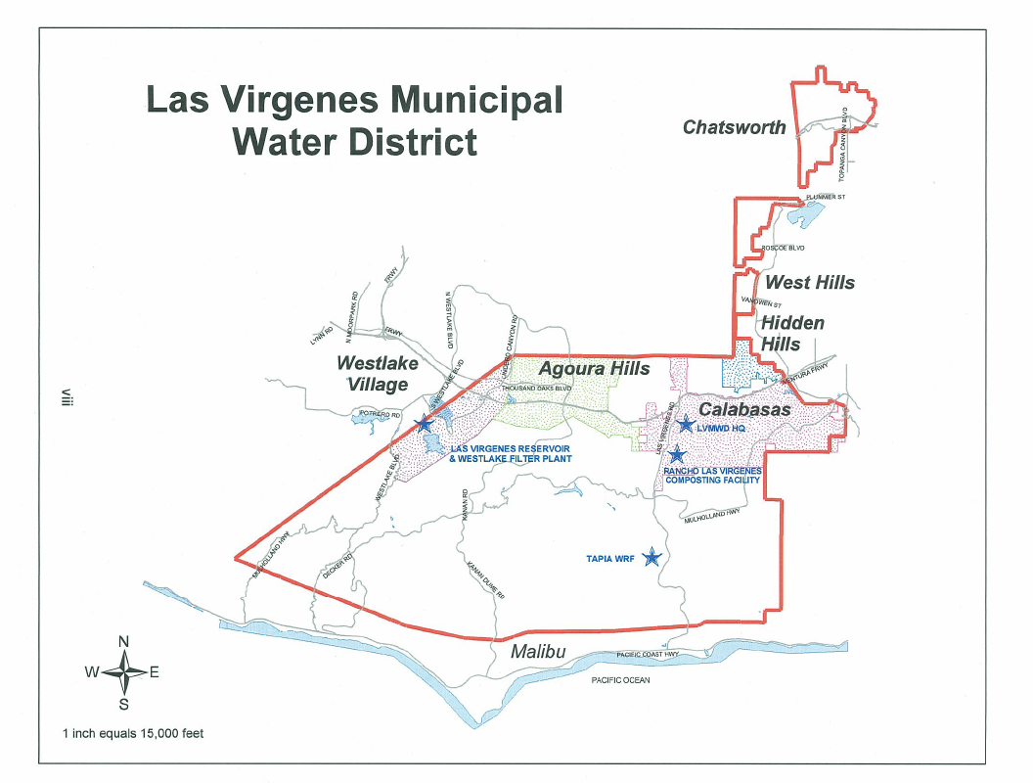
Service Area Map
The District is a special district formed for the purpose of providing water, sanitation and reclaimed water services to an area encompassing approximately 122 square miles in western Los Angeles County
Source: Las Virgenes Municipal Water District

Slide 8
History
Formed in 1958 to bring imported water into western Los Angeles County.
Serves the cities and communities of Agoura Hills, Calabasas, Hidden Hills, Lake Lindero, Malibu Lake, Twin Lakes and Westlake Village.
Provides potable water, reclaimed water and sanitation services to its customers. The District delivered its first water in 1963. In 1964, the District entered into an Agreement with Triunfo Sanitation District to provide sewage service to the Malibu Canyon Drainage area.
Has a separate distribution system for the delivery of recycled water for irrigation.
Currently serves approximately 19,854 potable water customers, 621 recycled water customers and 16,792 sanitation customers.

Slide 9
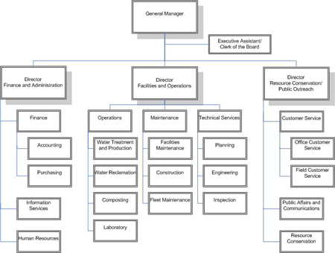
Management and Government
Governed by a five member Board of Directors
Elected by Districts on a non-partisan basis for overlapping four-year terms. The Board biannually selects officers and a representative to the board of MWD
The Board appoints the General Manager, responsible for day-to-day operations and appointing Department heads
District employs a full-time staff of 117 positions
Independent entity with sole authority to set rates

Slide 10
Key Facts
Potable Water is provided to the entire service area; wastewater treatment and recycled water provided through the JPA with Triunfo Sanitation District.
The District’s potable water system is rated the most complex by the California Department of Health Services, based on the number of customers served, the variety and number of system components and the rugged terrain.
Over 45% of the District’s service area is publicly owned and managed as park and open space.

Slide 11
Sanitation Facilities
A recycled water system comprising 3 storage tanks, 4 pumping stations, 3 reservoirs and 63.6 miles of recycled water pipelines
Over 56.2 miles of sanitary sewer pipelines, 2 lift stations and the Tapia Water Reclamation Facility with treatment capacity of 16.1 million gallons per day
Rancho Las Virgenes Composting Facility, which produces Class A compost
Rancho Las Virgenes Composting Facility treats 100% of the Sanitation System’s sludge
District is self-reliant and not dependent on other sanitation agencies for treatment of sludge

Slide 12
Sanitation Customer Base
Top 10 sanitation customers represent only 3.47% of Sanitation Operating Revenues

Slide 13
Regulatory Issues Facing the Sanitation System
EPA TMDL for Benthic Macro Invertebrates in Malibu Creek
Requires treatment to low nitrogen and phosphorous levels
Estimated infrastructure cost: $160M in 2005 excludes O&M, brine disposal and land
Likely included in 2015 NPDES permit
Expense depends on how much time is given to comply
District is engaging the community and the regulatory agencies on this matter

Slide 14
Household Median Income & Effective Buying Income
Exceeds National and State Averages
Source: The Nielson Company

Slide 15
Unemployment Rate
Service Area Cities & Unincorporated Los Angeles County
Unemployment rates in the District’s service area are well below county, state and national unemployment rates
*As of December 2012, Source: Employment Development Department of the State of California and U.S. Department of Labor, Bureau of Labor Statistics

Slide 16
C. Revenues and Rates

Slide 17
Sanitation Operating Revenues & Operating Expenses
Source: Las Virgenes Municipal Water District

Slide 18
Comparative Single Family Bi-Monthly Sanitation Rates
Other agency rates are as of September 2012 and are subject to change.
Source: Las Virgenes Municipal Water District

Slide 19
Sanitation Rates
 | Prior Charges | Winter Water Use (HCF) | 1-Jan-13 | FY 2013-14 | FY 2014-15
Single Family | $108.00 flat rate⁽¹⁾ | 10 or less | $74.31 | $74.31 | $75.80
 |  | 11 | $80.02 | $80.02 | $81.63
 |  | 12 | $85.73 | $85.73 | $87.45
 |  | 13 | $91.44 | $91.44 | $93.27
 |  | 14 | $97.15 | $97.15 | $99.10
 |  | 15 | $102.86 | $102.86 | $104.92
 |  | 16 or more | $108.56 | $108.56 | $110.74
Multi-Family | $68.03 flat rate⁽²⁾ | N/A | $68.59 | $68.59 | $69.97
Notes: (1) A 10% discount applies if potable water usage is 16 hcf or less ($97.20 bimonthly). There is no discount under the proposed rates. (2) A 10% discount applies if potable water usage is 12 hcf or less (each dwelling unit at $61.23 bimonthly). There is no discount under the proposed rates.
Charges |  | Prior Charges | 1-Jan-13 | FY 2013-14 | FY 2014-15
Commercial | Fixed Charges
 | Account Service Charge | $17.21 | $17.21 | $17.21 | $17.56
 | Per ERU^{(3) Charge} | $90.79 | $91.35 | $91.35 | $93.18
 | Variable Charge⁽⁴⁾
 | Class 1 (In excess of 29.5 hcf) | $3.08 | $3.10 | $3.10 | $3.16
 | Class 2 (In excess of 17.3 hcf) | $5.25 | $5.29 | $5.29 | $5.39
 | Class 3 (In excess of 11.4 hcf) | $7.96 | $8.02 | $8.02 | $8.18
 | Class 4 | As determined by the General Manager
Notes: (3) ERU is Equivalent Residential Unit or the water use pattern of a typical single family residence. (4) Sewage class depends on the type of business.
Source: Las Virgenes Municipal Water District

Slide 20
Billing Procedures
Customers are billed bi-monthly and have various ways to pay their bill
Water and sanitation charges are billed together
District has established procedures for late payments and accounts that are closing
Continuing customers must pay within two billing cycles (48 days) or sanitation services will be shut off

Slide 21
D. District Financial Management

Slide 22
Budget Process
Goal-setting workshops are held to help determine the direction of the Budget
Board of Directors adopts an operating and capital budget annually
Budget is based on information gathered, analyzed, and presented to the Board along with the Five Year Capital Improvement Plan
The Board reviews rates, fees and other charges every five years or earlier if needed following budget approval

Slide 23
Financial Management Tools
Reserve Policies
District maintains cash (net of restricted cash) in the Operations Fund of each enterprise equivalent to 25% of the operating budget plus one year’s debt service obligation
District maintains an Emergency Insurance Fund to cover deductibles, self insurance retentions, claims not covered by insurance, fines and disaster repairs
The target value for this fund is two percent of the total value of capital assets, including District’s share of the JPA’s capital assets
District maintains a replacement and major maintenance fund by Enterprise at cash levels deemed adequate to cover that enterprise’s projected needs for three years

Slide 24
Financial Management Tools - continued
Rates and Revenues
Policy that all revenues generated from District customers must support all District operations, including capital project funding
Water and sewer rates reviewed annually
District maintains a Rate Stabilization Fund for the Potable Water System to maintain rate stability for customers in times when short or mid-term operating revenues needs are tight
District prepares a rate model for its Potable Water, Recycled Water and Sanitation Systems

Slide 25
Financial Management Tools - continued
Investment Policy
Reviewed annually and readopted with the objective of safety, liquidity, and yield
Monthly investment reports are distributed and reviewed by Finance Committee Board members
Healthy investment portfolio
Forward planning of capital needs
5-year capital improvement plan reviewed annually
Insurance
District has general liability, property, auto and physical damage insurance coverage through American Alternative Insurance Corporation
District has worker’s compensation insurance coverage through ACWA JPIA

Slide 26
Sanitation System Historic Coverage
Includes grant revenues and revenues from the sale of assets.
Source: Las Virgenes Municipal Water District

Slide 27
Forecast
Source: Las Virgenes Municipal Water District

Slide 28
E. Capital Facilities

Slide 29
Capital Improvement Program
Source: Las Virgenes Municipal Water District

Slide 30
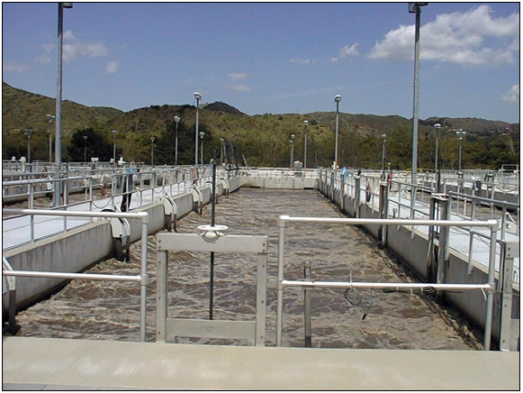
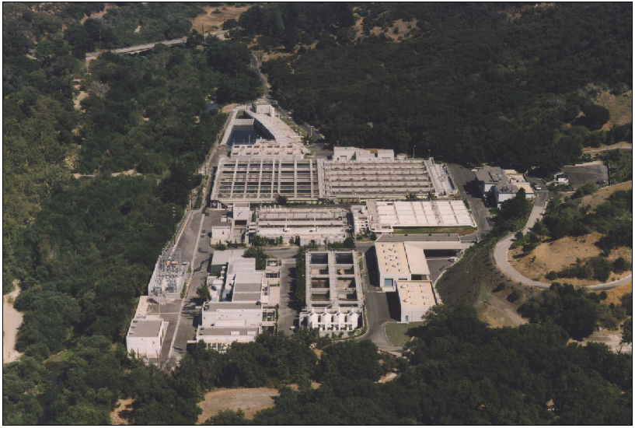
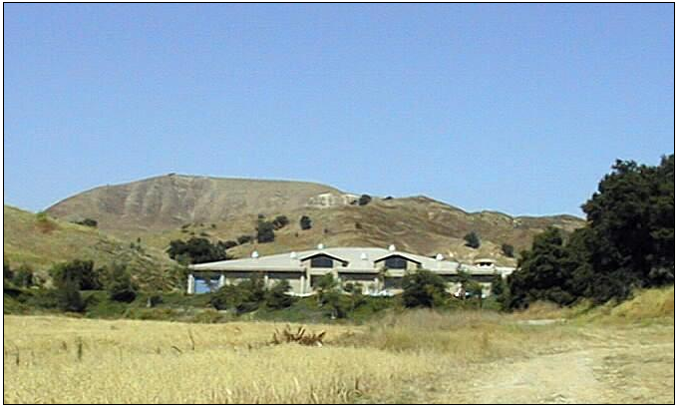
District Facilities

Slide 31
Sanitation System Capacity & Average
Daily Dry Weather Flow
Wastewater treated (in MGD) historic and projected
Treatment Plant Capacity: 16.1 MGD
Source: Las Virgenes Municipal Water District

Slide 32
F. Summary

Slide 33
LVMWD is Characteristic of a Strong “AA” Credit
Strong and stable service area economy and revenue base
Wealthy population near build-out
Excellent financial position
Diversified revenue base
District commitment to strong debt service coverage
Established Reserve Policy to segregate one year of debt service payments into separate accounts in addition to the 25% of operating and maintenance costs
Minimal Sanitation Capital needs and Treatment Capacity exceed flows
Strong operational and policy management
Involved Board of Directors
Seasoned Management Team
Master Plan for 30 year development outlook
Strong Financial Management
Adopted Policies for Reserves, Investment and Budgeting
Rate Model for Water and Sanitation Enterprises
Long Term Planning focus based on five-year Infrastructure Investment Plan

Slide 34
G. Water System Financing Preview

Slide 35
Future Water System Financing
District is exploring the possibility to bond finance several of its Water System capital improvement projects
In Summer of 2012, a Rate Study was prepared with the goal to develop multi-year financial plans for the District to:
Ensure all revenue requirements are met and
Recommend changes to the existing Potable Water Rates

Slide 36
Future Water System Financing - continued
Based on the recommendations made in the Rate Study, the Board implemented:
three year rate increases to Potable Water Rates
five year increase in rates to reflect a 5% revenue adjustment offset by MWD Rate increases
New Potable Water Rates took effect on January 1, 2013
New Water Rates provide:
Future revenue stability
Increase funding of reserves
Bonding capacity

Slide 37
Questions and Further Discussion

Slide 38
Contact Information
Sandra Hicks Director of Finance and Administrative Las Virgenes Municipal Water District 4232 Las Virgenes Rd., Calabasas, CA 91302 (818) 251.2133 | shicks@lvmwd.com | Joseph Lillio, MPA, EA Finance Manager Las Virgenes Municipal Water District 4232 Las Virgenes Rd., Calabasas, CA 91302 (818) 251.2128 | jlillio@lvmwd.com
Jim Fabian Principal Fieldman, Rolapp & Associates 19900 MacArthur Blvd., Suite 1100 Irvine, CA 92612 (949) 660.7307 | jfabian@fieldman.com | Josh Lentz Assistant Vice President Fieldman, Rolapp & Associates 19900 MacArthur Blvd., Suite 1100 Irvine, CA 92612 (949) 660.7320 | jlentz@fieldman.com

