Slide 1
Data-driven water management

Slide 2
IOSight – Overview
A leading data-driven water management platform
More than 100 installations, world-wide (since 2008)
Expanding to global markets
A Unique Combination of Technology, Team, and Customer Experience
Water and Wastewater Utilities and Facilities
Desalination
Energy

Slide 3
Our product suite – The water utility data hub A single source for reliable data-driven management
Technology hub – integration with diverse solutions (ours and 3rd party)
Data foundation – collection and cleaning
Outputs – dashboards and reporting
Event management solution – prevention and response
Advanced analytics – AI and ML based algorithms
Early fault prediction
Water quality anomaly detection
Sustainable facility optimization
Water loss management

Slide 4
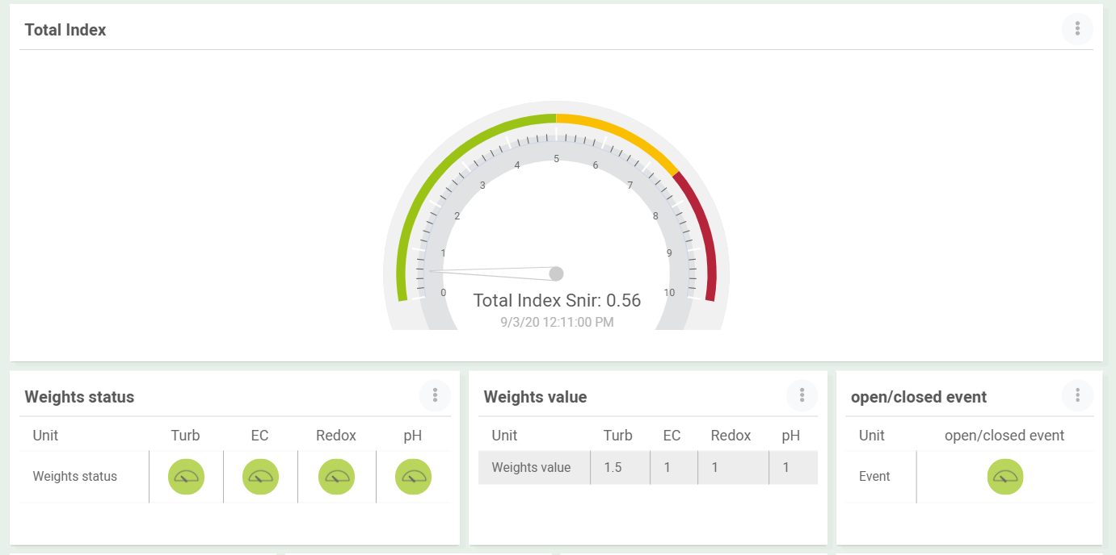
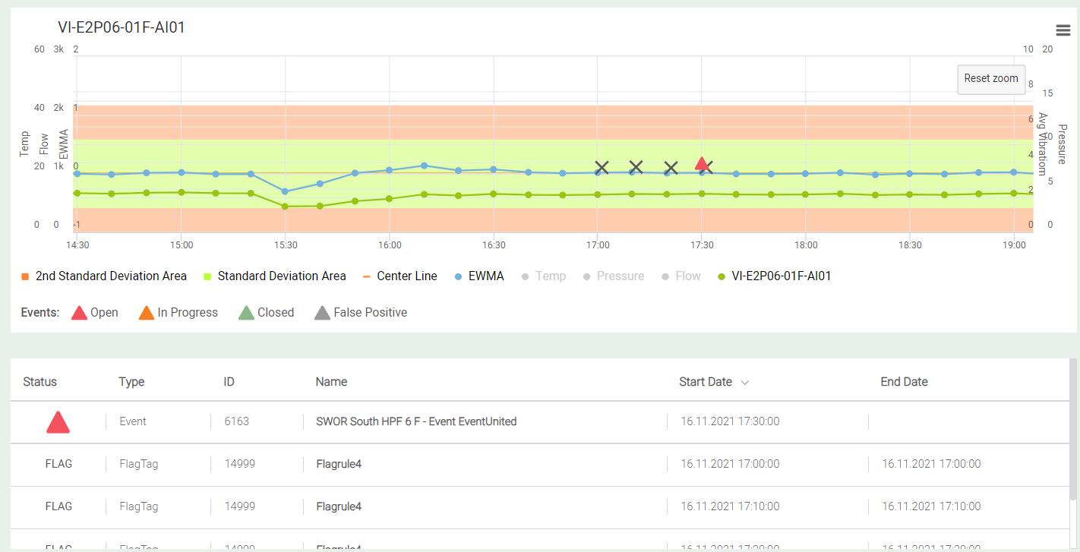
Anomaly Detection and Early Fault Prediction
Water Quality Monitoring in Rivers and Watersheds
Contamination / anomaly detection
Downstream propagation
Elimination of 95% of false alerts
Early Fault Detection Engine
Machine failure
Quality exceptions
Flow and pressure anomalies

Slide 5
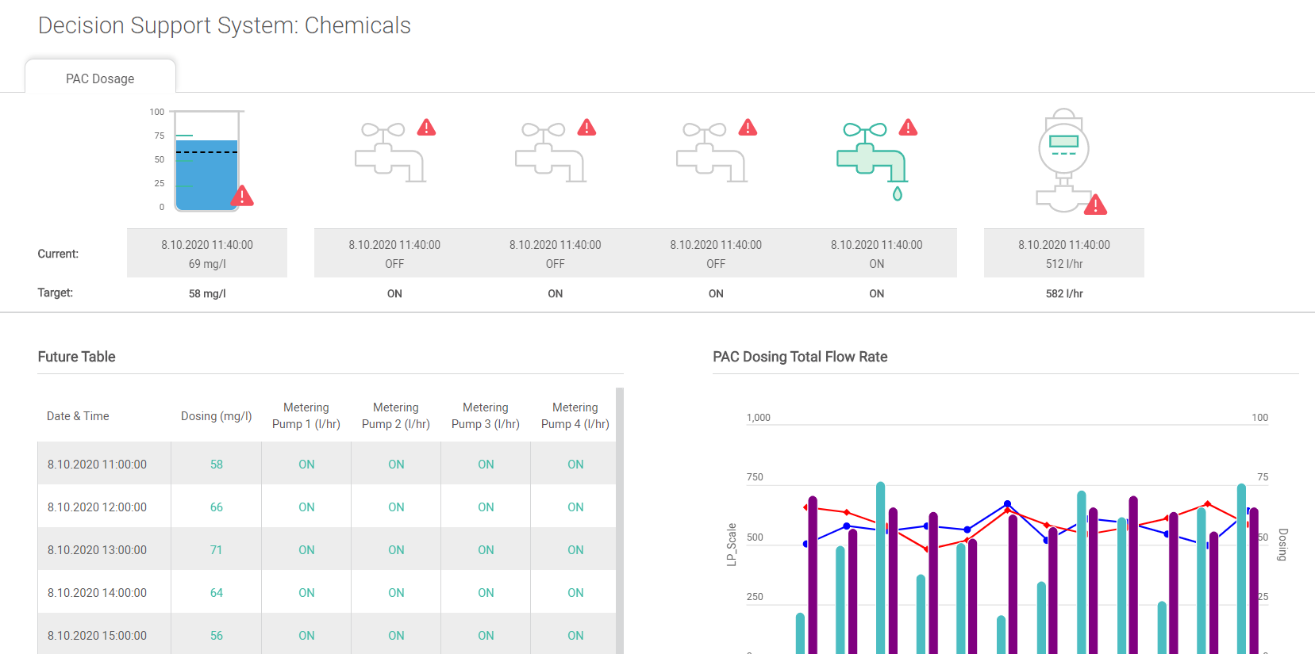
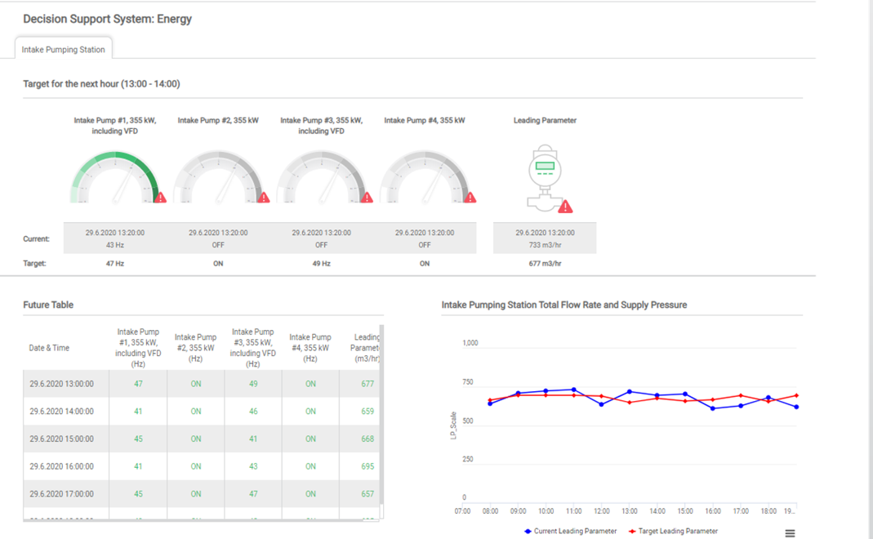
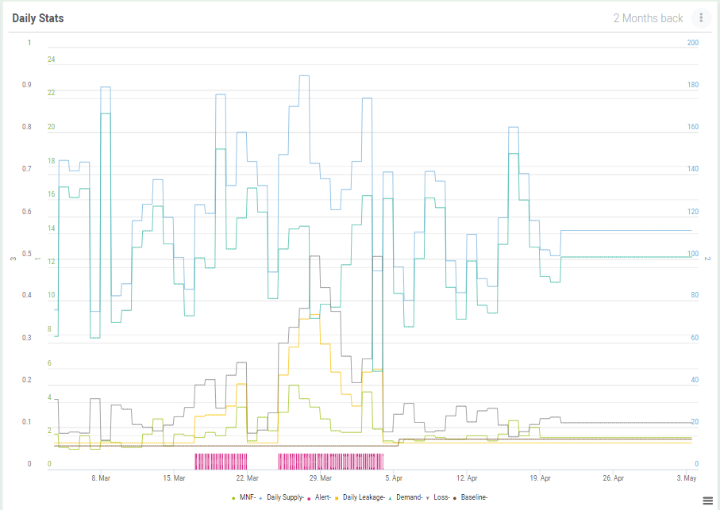
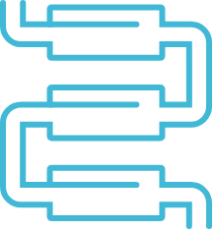
Facility Optimization
Optimization for WTPs and WWTPs
Energy consumption of pumps/blowers
Chemical dosing
Up to 10% cost savings
NRW in District Metered Areas (DMAs)
Online water balances based on Minimum Night Flow (MNF)
Water-loss decision-support system
Detecting anomalies and potential bursts

Slide 6
THANK YOU
iosight.com

