Slide 1
Security Failover Technology​
Redefining the Very Essence
of ICS & OT Resilience
​ ​
and you’re back on track!
Gwen Krauss
VP Sales NA
gwen.krauss@Salvador-Tech.com

Slide 2
Salvador Technologies addresses a crucial problem concerning operational continuity and cyber attack recovery for mission critical systems.
Our solution provides instant security failover for ICS/OT systems, that is fast and easy to use. ​
Manufacturing
Critical Infrastructures
Energy
Maritime
Medical
BMS
Logistics
| 2

Slide 3
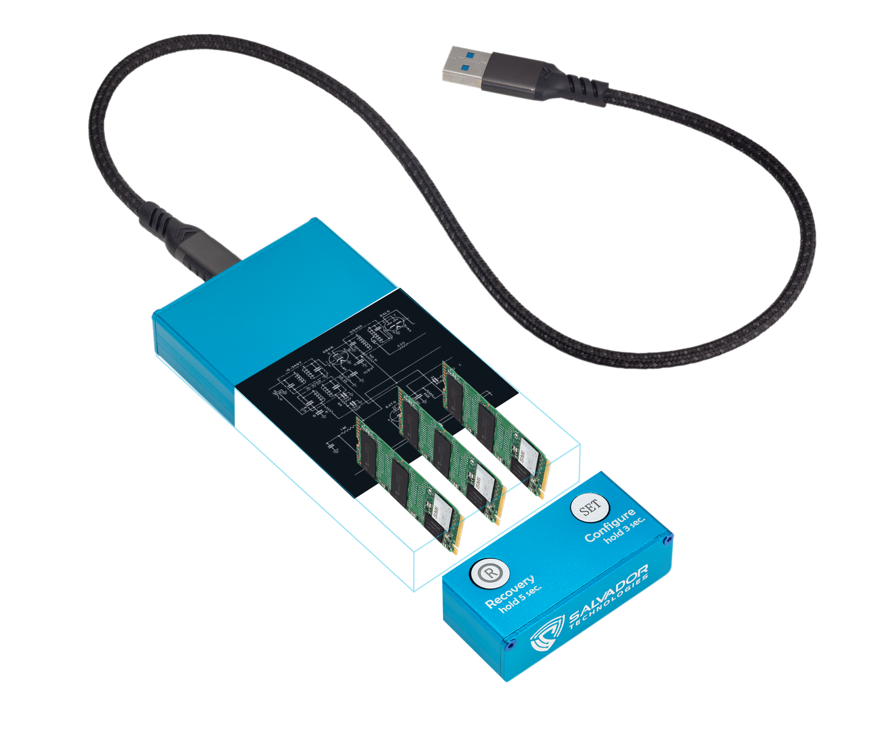
What makes it Unique?
Boot from device: All copies include the entire disk, all files necessary to boot; OS, configurations, licensing and data files.
Patented Air Gap: After original clone of machine, the disk disconnects and remains electronically offline making it invisible to hackers.
Hacker proof: The software will not allow any external or internal control of this functionality from the computer.
Canary Files: We install canary files on customer backup to monitor for encryption/ransomware.
Available capacity: 3 x NVMe drives
options: 512GB / 1TB / 2TB / 4TB
| 8
Notes:
How are we different from traditional backups
Air gap technology
Once the backup is finished, this disk will be disconnected and remained in a permanent air-gap state.
The other 2 disks will make the copies alternately, according to the frequency you set: daily, every 2 days or weekly, then also disconnect when not backing up.
Disconnecting electronically makes these disks invisible and unreachable to hackers
The cyber recovery unit contains 3 NVMe disks, best in speed, that make copies of the entire image - everything you’d need to boot from the device; operation system, configurations, licensing, and data files.
Other security protections like Canary files

Slide 4
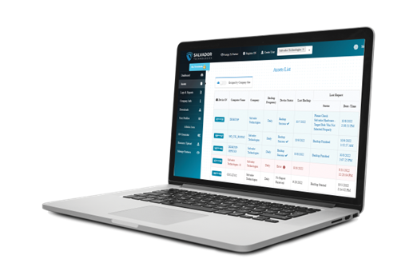
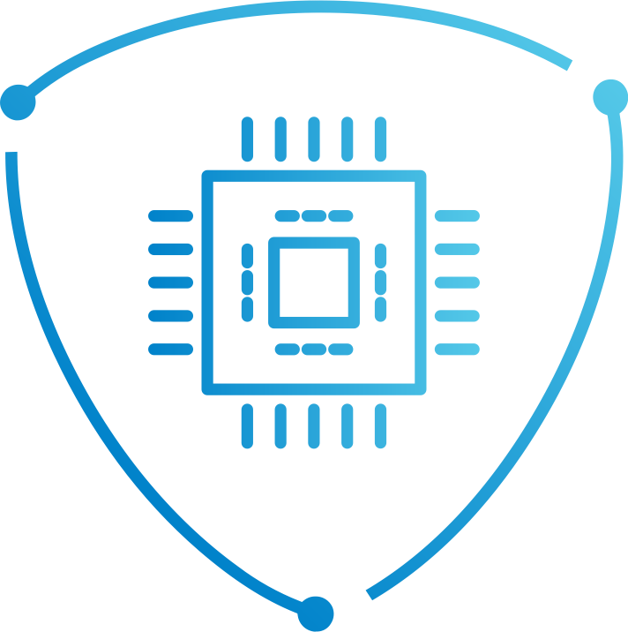
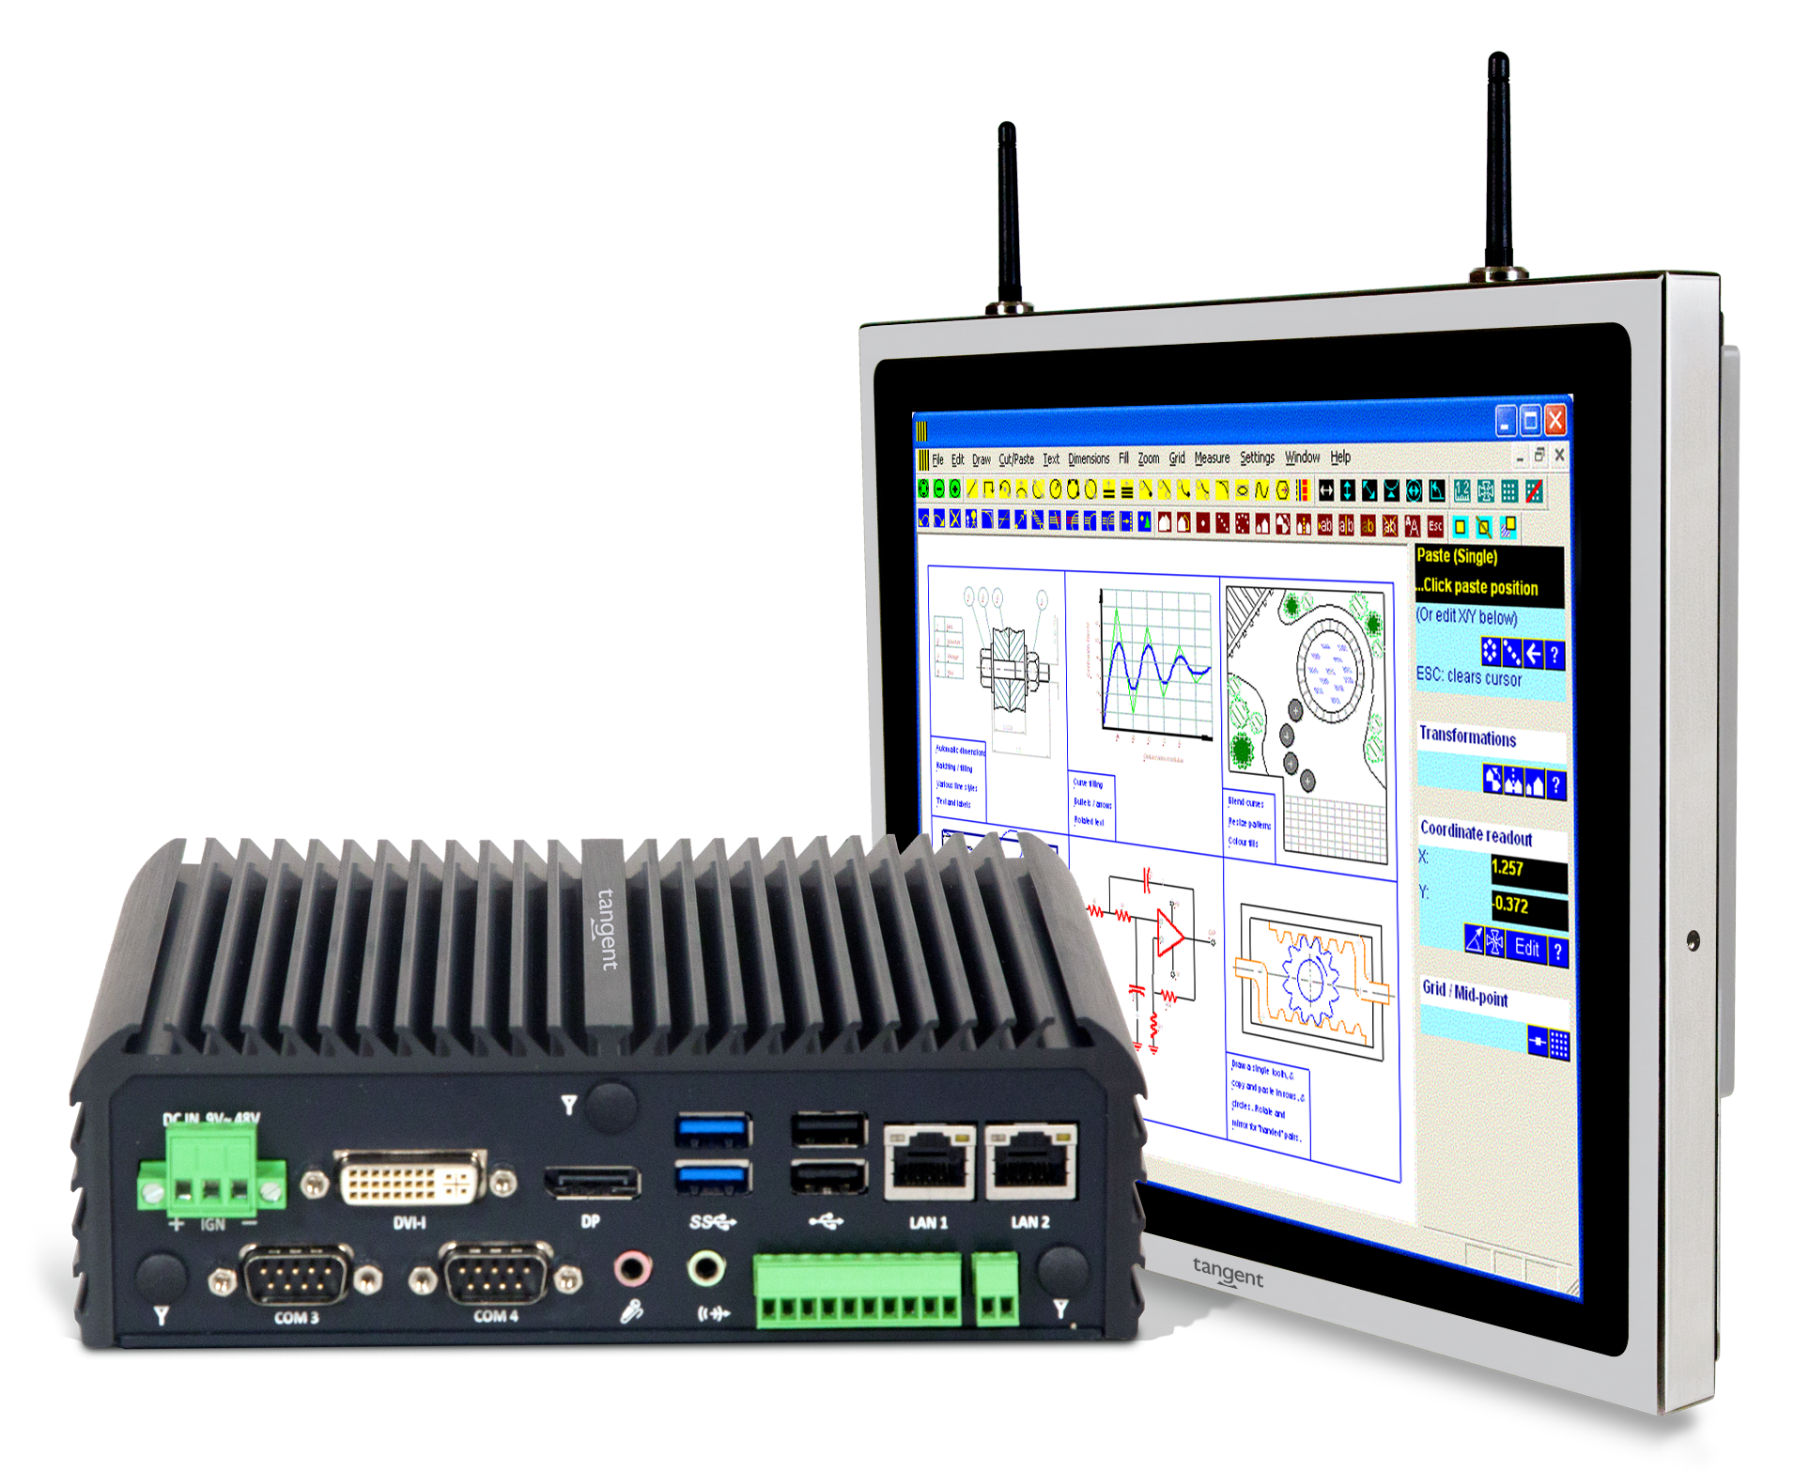
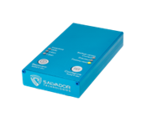
3 Layers of Defense
Air Gap
Protection
Innovative Recovery
Software
Continuous
Monitoring
and you’re back
on track!
| 4
Notes:
Our solution consists of 3 layers of defense:
A monitoring system interface that gives you full visibility of the status of each workstation.
An agent software that is installed on your computer that works with the unit. Also an agentless option.
A cyber recovery unit, that is connected by USB to your computer, HMI or server

