Slide 1
Advanced Acoustic Solutions for Water Conservation & Non-Revenue Water (NRW)
Ken Malone
Western Region US
Cell: 760.822.6800
Ken.malone@aqs-systems.com

Slide 2
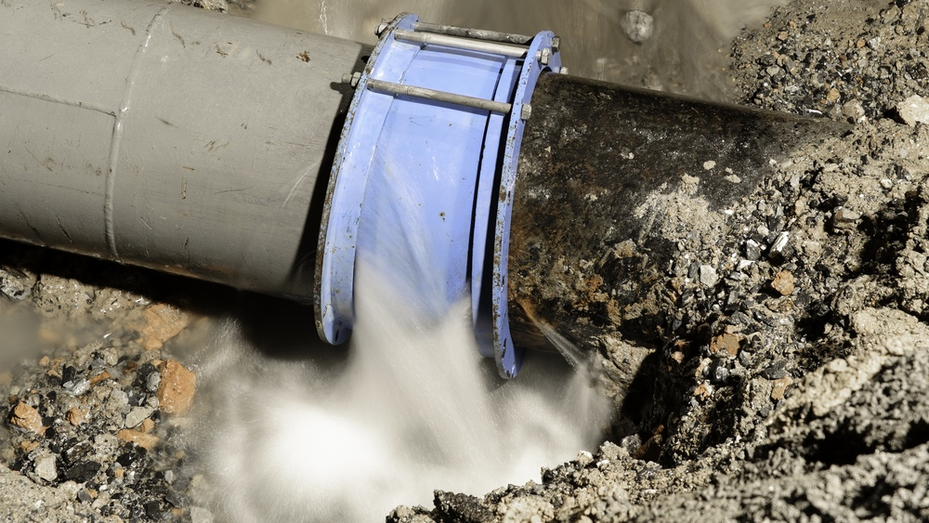
Utility Business Drivers
35 %
of the water distributed in networks is lost through leakages
Climate change and droughts
Aging workforce
Energy costs
Environmental concern
Political pressure
Cost of pipe replacement

Slide 3
Our value proposition
Alerting to pipe bursts and reducing water loss by at least 20%.
Accurate leak detection and leak location for all pipes materials and diameters
Condition assessment by analyzing historical repairs and real-time leaks.
An automated monitoring system with built-in data analysis capabilities. A friendly user interface and human support enable efficient network management while optimizing operational personnel workload.

Slide 4
Professional Services & Support: Customer Success Team

