Slide 1
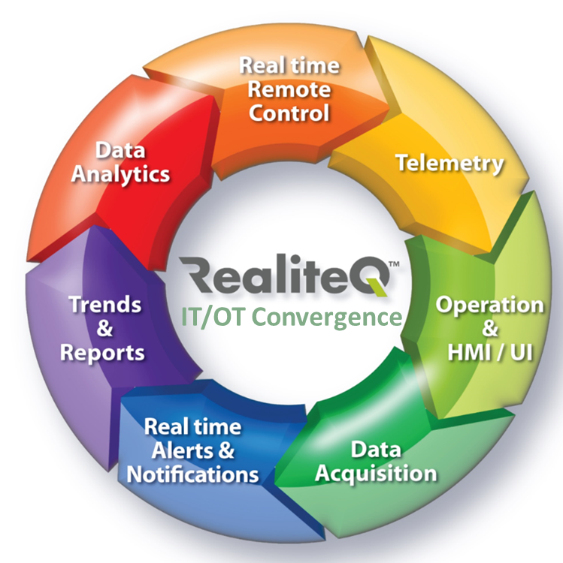
Real-time remote-control & data management Holistic platform
IIoT and cloud technology
By Ran Kedem – Partner at Reali Technologies

Slide 2
About Reali Technologies Ltd.
Reali Technologies Ltd. is an Israeli pioneer company in IIoT & cloud computing since 2008 and in water (IOW – Internet of water) since 2009, the developer of RealiteQ Suite –Real time remote control and operational data management platform
Today RealiteQ is a proven technology for wide range of applications, with thousands of installations in more than 40 countries including (USA)
Global Installations
Installations in Israel
Worldwide Installations

Slide 3
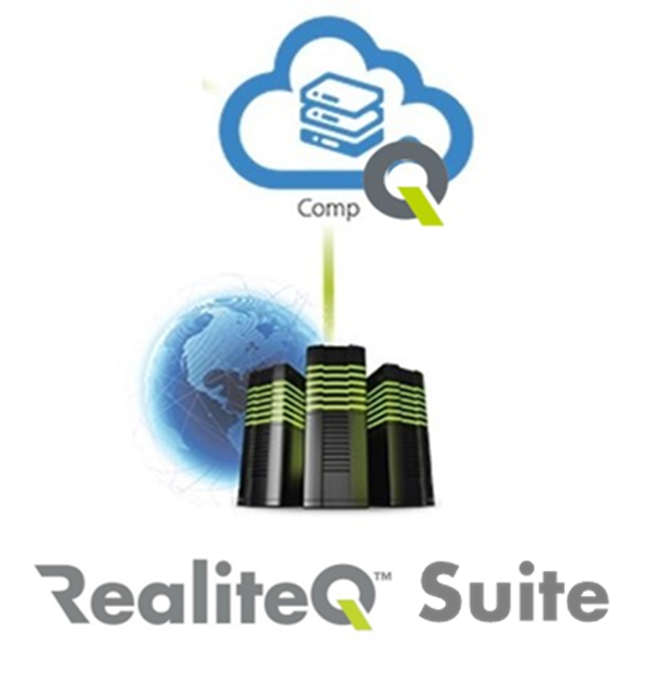
RealiteQ - What is it?
Operational suite
Administrative suite
RealiteQ Suite
Integrated Bundle of IOT & cloud programs & tools:
Gateway - Telemetry - VPN – SCADA HMI Developer/editor - Cloud - Cybersecurity - Backups - - Notifications & Alerts - Historian Reports - Trends – BI Dashboard - More…

Slide 4
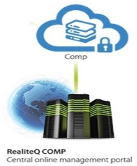
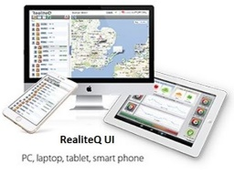
RealiteQ Vs. Traditional SCADA HMI
Site/ network
RealiteQ Holistic SCADA solution – “All-in-One” integrated solution
Servers
Data acquisition
Telemetry/ Remote control
VPN
Remote prog
SCADA
HMI
BI Dashboards
Cyber security
Supplier 1
Supplier 2
Supplier 3
Supplier 4
Supplier 5
Supplier 6
Supplier 7
PLCs, analyzers
sensors…
VPN
Traditionall SCADA system –integration of several hardware & software from different providers
Much more then “Just” SCADA

Slide 5
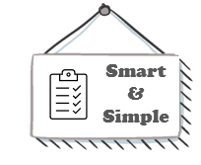
RealiteQ Benefits Vs. Traditional SCADA solution
Easy to install, use & maintain
Built for Cyber – Highly secured
Data easily accessible
Affordable –
Low CAPEX & OPEX
Smart – Simple – Secured - Affordable

Slide 6
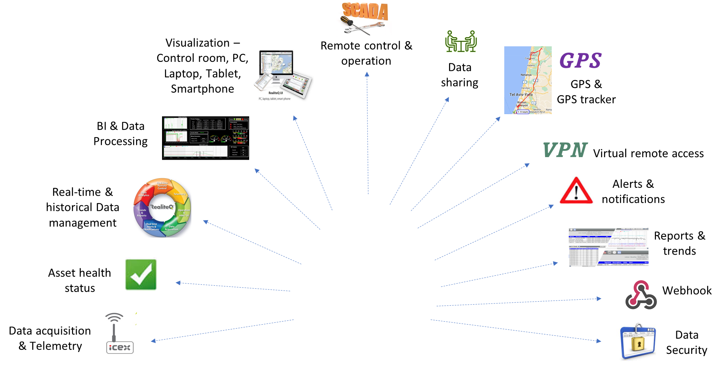
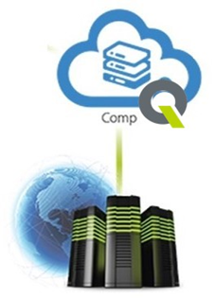
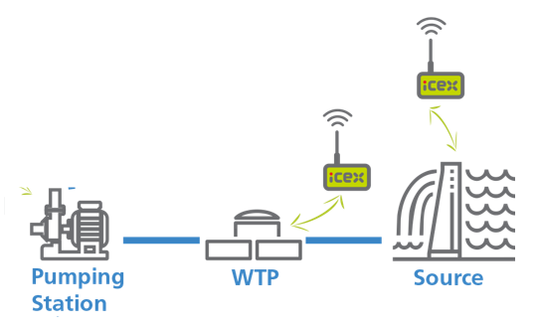
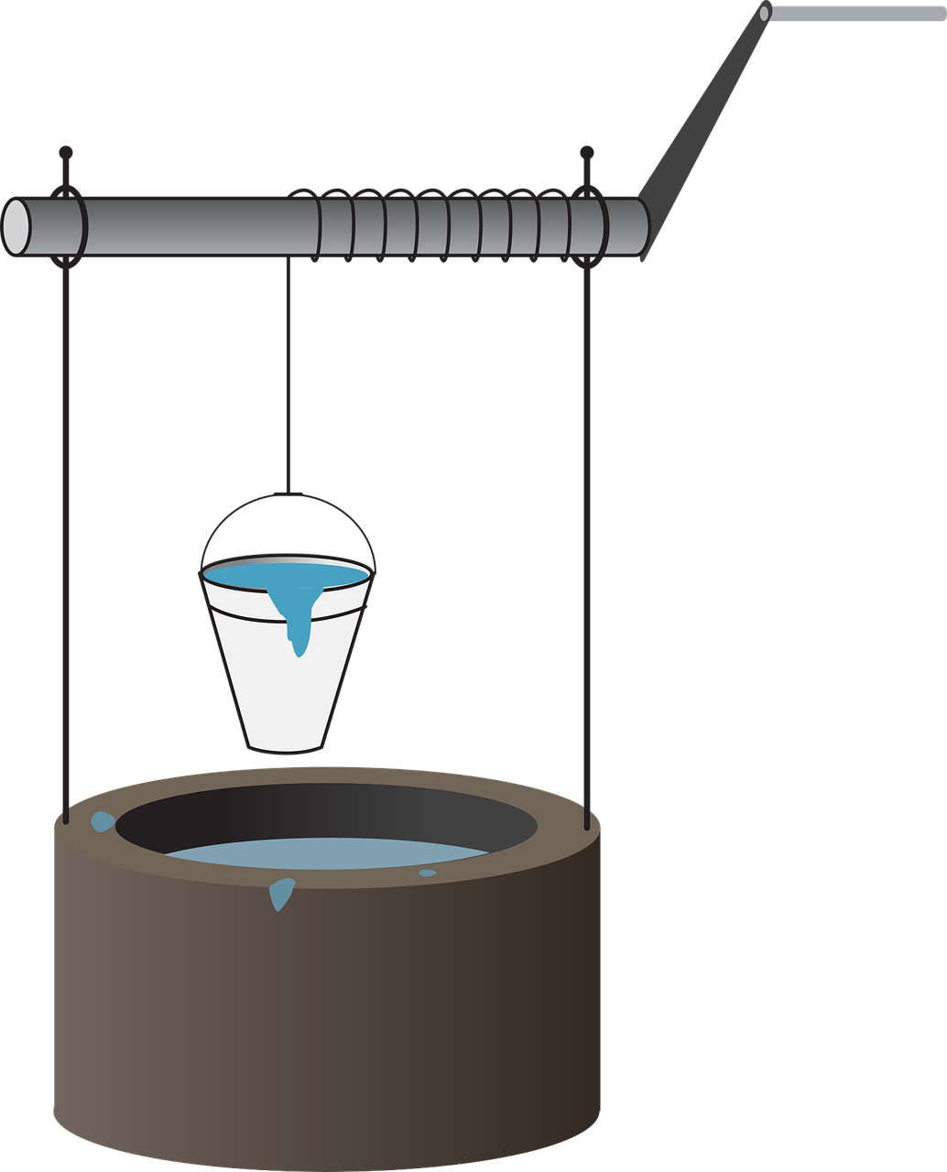
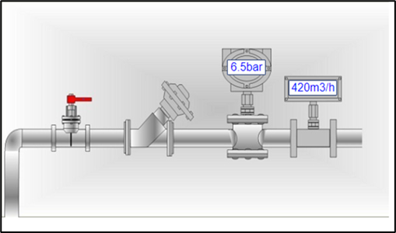
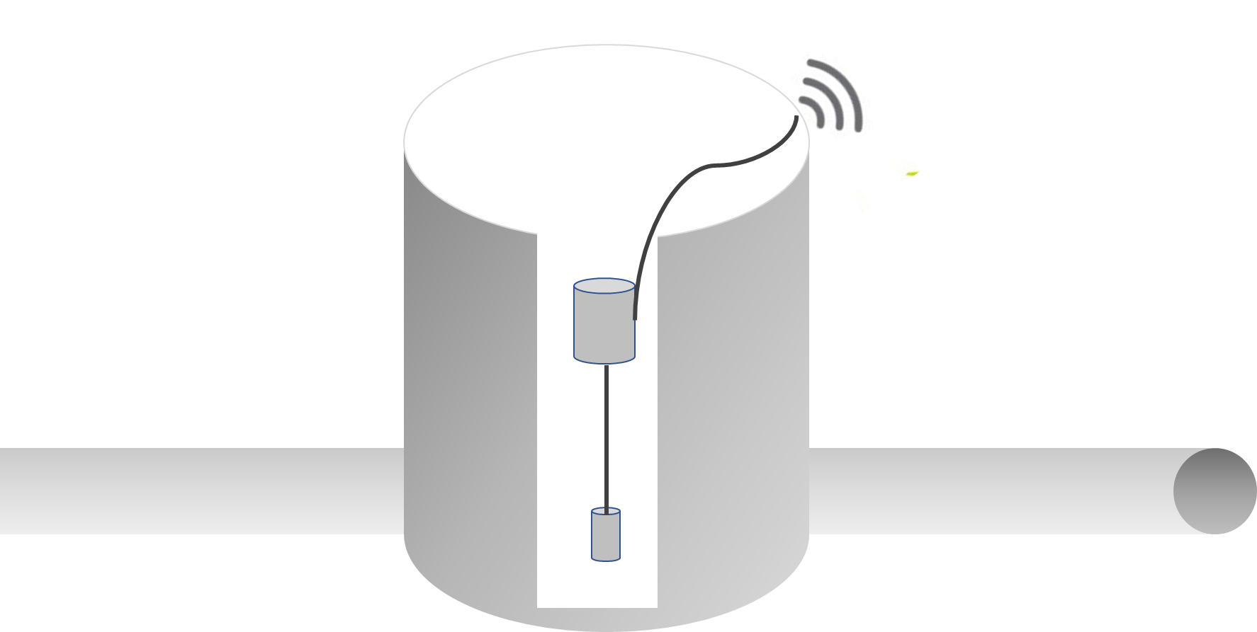
RealiteQ smart water network architecture
3 - Real-time data Usage
Control Room
Internal users
External users
3rd party software
2 - Real-time Data management & processing
1 – Real-time Data acquisition, telemetry & Aggregation
Water reuse
WWTP
sewage manhole
Water tower
Water well
District water chamber (DMA)

Slide 7
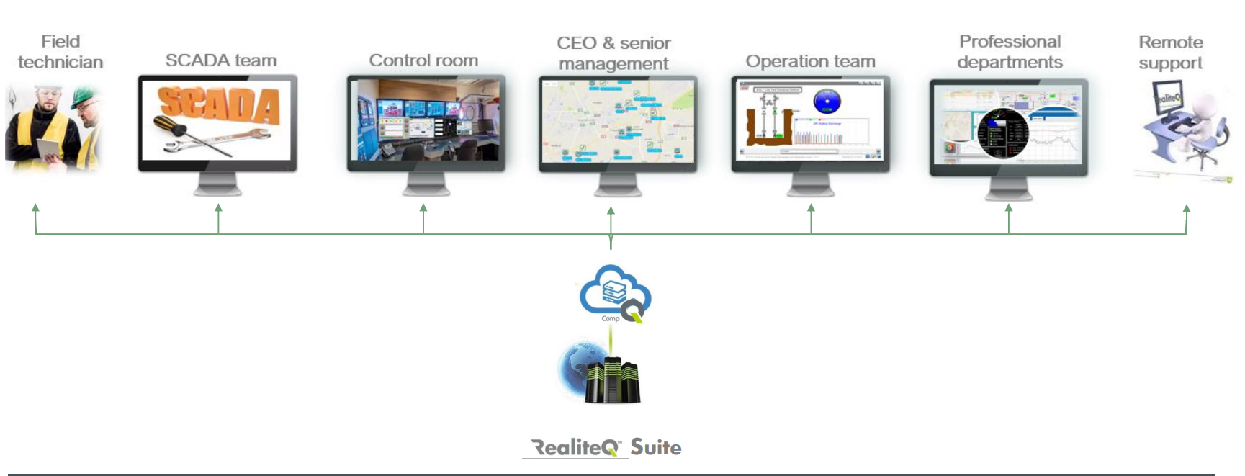
RealiteQ – It is all about data
Unlimited data (Tags) & users with no extra costs!
Real-time data sharing
Real-time data aggregation & integration
Real-time data processing
Real-time remote control
Real-time alerts & notifications
Outsourced consultant
Real-time data sharing
Making data easily available to all

Slide 8
Reali Technologies LTD.
Ran.kedem@RealiteQ.com www.RealiteQ.com
Papa, it is So sad, they couldn’t use RealiteQ
Advanced – Simple – Secured - Affordable

