Slide 1
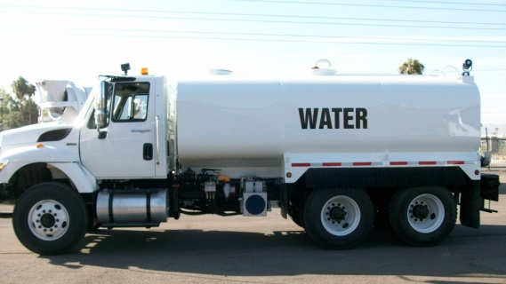
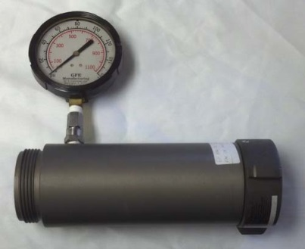
RESTRICTIVE PERIOD
PHYSICAL FIRE FLOW REQUIREMENTS - $100.00
Due to the current drought conditions, onsite fire flows are being restricted at this time. In approved cases, the applicant will need to:
Hire a flow company that will be required to present to the LVMWD Inspector the following: Submit a written procedure on how they will perform the test. The test will need to be approved by the LVMWD Inspector.
The flow company needs to show they have a water truck big enough to hold sufficient flow during the test along with an enclosed Pitot tube. (No water leakage shall take place during the test) District staff/Inspector will instruct on where the water is to be relocated.
The flow test date will be coordinated with the LVMWD Inspector who will inspect the equipment on site that will be used to perform the fire flow test. If all is approved, the test will be allowed.

